Slide 1

Scientific Board and Working Group Highlights
Report 2024/2025
Hilde Orten and Darren Bell, Co-chair of the DDI Alliance Scientific Board
DDI Alliance Annual Meeting of Members
Virtual meeting 2025-06-10

Slide 2
Members of the Scientific Board
Chair (2021- 2025, 2025 - 2029. Vice chair 2021 - 2023, chair 2023 - 2025)
Hilde Orten, Sikt - Norwegian Agency for Shared Services in Education and Research
Vice Chair (2021-2027. Vice chair from 2023)
Darren Bell, UK Data Service
Members
Flavio Rizzolo, Statistics Canada, 2021-2025
Ingo Barkow, University of Applied Sciences of the Grisons, 2021-2025
Simon Hodson, CODATA, 2021-2025, 2025 - 2029
Wolfgang Zenk-Möltgen, GESIS - Leibniz Institute for the Social Sciences, 2021-2027
Jared Lyle, ICPSR, DDI Alliance Executive Director, ex officio, 2021-present
Wendy Thomas, Minnesota Population Center, Technical Committee Chair, ex officio, 2021-present
Dan Smith, Colectica, 2023 - 2027
Welcoming new members starting July
Amber Leahey, Borealis and ScholarsPortal
Noemi Betancort, SuUB Library in Bremen and the Research Data Center Qualiservice

Slide 3
Contacts
W3C Contact: Darren Bell
ISO TC46/SC4 contact: Dan Gillman
UNECE contact: Flavio Rizzolo, Arofan Gregory

Slide 4
Committees and working groups under the Scientific Board
Technical Committee (also had important technical governance responsibilities)
Training Working Group
Controlled Vocabularies Working Group
Cross Domain Integration (CDI) Working Group
DDI Developers Group
Structured Data Transformation Language (SDTL) Working Group
RDF Equivalence Working Group
Questions and Questionnaires Working Group
XKOS - Extended Knowledge Organization System Working Group
Glossary Working Group
Temporary group focusing on ISO certification for DDI

Slide 5
Activities of the Scientific Board in the past year
Meetings and events
Virtual SB meetings
Monthly. Meetings in between those as needed
EB/SB coordination calls
Quarterly. Led by Jared Lyle, DDI Alliance Executive Director
Physical Scientific Board meeting
Chur 2 December 2024
Scientific Board Working Group contact meetings with Working Groups
Event with DDI Alliance Executive Director, the EB and SB together at EDDI 2024

Slide 6
Activities of the Scientific Board:
2024 - 2026 Scientific Work Plan
Structured in terms of the three Strategic Priorities of the Strategic Plan
1) ENGAGEMENT
2) EXPANSION
3) ALIGNMENT
Goal oriented
Continuous vs. time specific tasks
Implementation by the Scientific Board, TC, the Working Groups, contacts and other initiatives.

Slide 7
Activities of the Scientific Work Plan - 1
Ongoing activities in bold
1) ENGAGEMENT
1.1 Signposting and marketing recommendation
1.2 Stakeholder map and single sources of truth for stakeholders
1.3 W3C collaboration and possibilities of W3C recommendation for DDI components
1.4 Broaden scope and opportunities for DDI tools development

Slide 8
Activities of the Scientific Work Plan - 2
Ongoing activities in bold
2) EXPANSION
2.1 DDI Alliance DDI registry, pid usage and resolution mechanisms
2.2 Develop and enable community submissions of markup examples for all products
2.3 Engage with and explore possibilities for DDI adoptions in cross-domain initiatives and standards including FAIR and CDIF
2.4 Engage with the SDMX community and the UNECE community to identify future collaborations
2.5 Increase the visibility of the Alliance beyond traditional audience regions
2.6 Feasibility and scoping report for ISO certification
2.7 Support further development of implementation guides to help software architects and developers
2.8 Pursue funding opportunities in geographies the DDI Alliance has members

Slide 9
Activities of the Scientific Work Plan - 3
Ongoing activities in bold
3) ALIGNMENT
3.1 Align and standardise technical documentation practices
3.2 Formal Information Architecture and Content Management Strategy for the Alliance
3.3 Support development of a new integrated Training Platform and Media Library
3.4 Liaise with EB to develop a more formal Communication Strategy and apparatus
3.5 Improve collaboration and communication between the SB and the WGs, including more formal periodic reporting
3.6 Support TC in infrastructure consolidation and harmonisation
3.7 Support development of RDF serialisations for DDI products that don’t have them
3.8 Support and release of new products and product versions

Slide 10
Planned activities
Main tasks
Plan and carry out activities aligned with the Scientific Work Plan 2024 - 2026
Follow - up with contributors on tasks from the Scientific Work Plan
Half yearly WG reporting
Follow-up with the Working Groups by SB contacts
Approving and sun-setting of WGs
Physical meeting in Budapest in connection with EDDI 2025

Slide 11
ROADMAP 2023/2027
Technical Committee
Main Activity Areas
Separation of specific product development
Overall model of DDI coverage
Shift to coverage development FOLLOWED by integration into individual products
Development of products to support DDI Suite usage and application
Production tools management plan
DDI Alliance Web Site
Resolution support forRDF syntaxes, CV's, etc.
Development Environment for Products
Working with Developers group on support for implementers
https://docs.google.com/spreadsheets/d/1b390D4CpPXqtqi7-e5GhrvWdHbNEG697/edit?usp=sharing&ouid=102757977752490519555&rtpof=true&sd=true

Slide 12
2024/25 ACTIONS
Transfer of DDI-Lifecycle production to COGS
DDI-Codebook v2.6 review
Movement of DDI Web Site to HubSpot
Establishment of RDF resolution for Controlled Vocabularies
Moved development work to DDI GitHub
2024/25 FOCUS
Model of DDI Coverage
Implementation Guidance
DDI Google Documents
Improvement of DDI Web Site
Automation of product production pipelines
NEW PRODUCT WGs FOR COODEBOOK AND LIFECYCLE

Slide 13

Website & UX Feedback
New website in a nutshell
ddialliance.org migrated from Drupal to Hubspot at end of 2024
In parallel, creation of docs.ddialliance.org on AWS
Migration work undertaken by Technical Committee (TC)
Challenges included volume of legacy content, database cleansing, URL/redirection inconsistencies, and deployment issues
Priority in 2024 was to get the site off the legacy Michigan infrastructure. Priority in 2025/2026 is to optimise the context and UX

Slide 14
Next steps
ICPSR UX team to create more wireframes for templates.
TC to implement recommendations where possible (search functionality is a priority)
Perhaps some minor consultancy for implementation of more complex feature e.g. JavaScript customisations.
Current issue list on Jira being worked through by TC

Slide 15
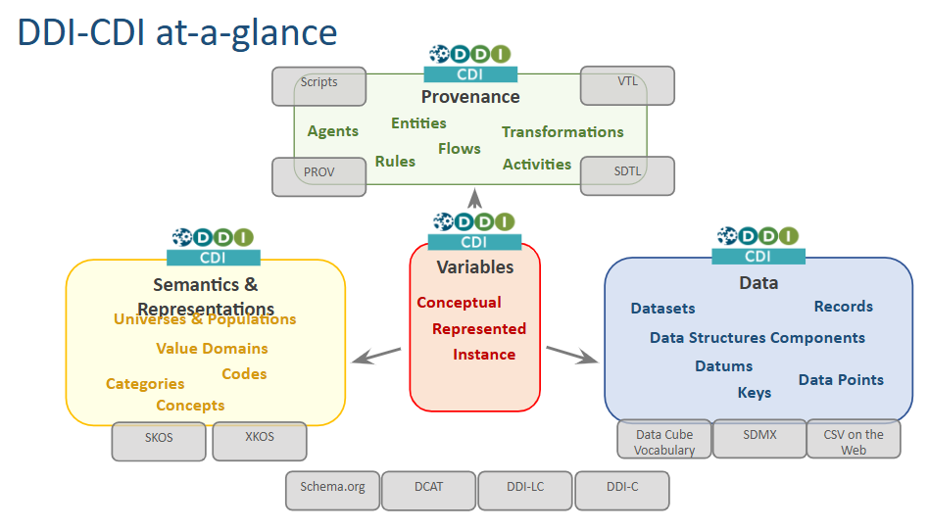
DDI-CDI
V1.0 published
Describe data from other domains
Probably structured differently (sensor/event data, multi-dimensional data, big data, etc.)
Likely encoded using non-XML technology (e.g. RDF and Web standards)
Often described with different terminology/semantics (explicitly or implicitly)
Work well with others
Integration mechanism for DDI products
Direct support for non-DDI standards/models (i.e., SKOS, DCAT, etc.)
Capture provenance
Data is usually coming from diverse data production paradigms
Production context and implicit assumptions need to be provided for accurate interpretation and integration

Slide 16
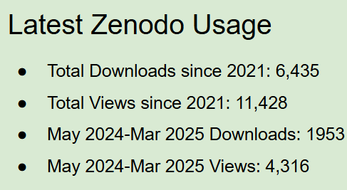
Training Working Group
Events
Webinar w/CODATA - Questions and Survey Instruments in DDI: Maximizing the Value of Your Metadata.(link to recording and slides)
IASSIST 2024 - Poster - DDI training materials: A metadata management training resource,
EDDI 2024 - DDI Training Working Group - Train the Trainer Collaboration Workshop
IASSIST 2025 Presentation
Slide decks published 2024-2025
Korean versions of 3 Intro Decks
How to Document Data Quality with DDI
Understanding Metadata
On demand training
ONTOLISST project - the HUN-REN Data Documentation Archive
WestEd Overview of DDI Training

Slide 17
Questions and questionnaires group
Established 2024
Mission
• Provide guidelines for building and managing questionnaires
• Identify needs for new material and evolution of the standards
• Long-lived initiative
Past activities
• Survey to identify needs
• EDDI24
Presentation of the survey results (BoF session)
Workshop to set directions
Goals
• Improve the Getting started section for Questionnaires in DDI (Strategic goal 1.1)
• Develop Guides and best practices documents (SG 1.1)
• Provide real life example of questionnaires in DDI (SG 2.2)
• Update the tools list and description (SG 1.1)

Slide 18
DDI Developers Hackathon v3.1 2025
Side meeting to EDDI 2025
Same location as EDDI
Wednesday 03/12 -> Welcome reception – KEG
Thursday / Friday – Hacking in groups
Thursday 04/12 -> Pizza Party
Friday 05/12 -> Thank You Dinner – Trofea Grill
Free of costs, limited travel support possible
All are welcome (not only developers)
Call for challenges in summer

Slide 19
Progress so far
DDI and W3C Collaboration
Business driver comes from both the EB Strategic Plan (Build partnerships with other standards) and the SB Workplan (Deepen connection with W3C and explore the possibilities of a W3C recommendation for DDI components, such as the variable cascade).
Initial conversations with W3C representative at Dagstuhl 2023 Pierre-Antoine Champin
Rather than creating a brand new W3C working group, the path of least resistance is to “re-charter” the existing Dataset Exchange Working Group (DXWG) https://www.w3.org/2017/dxwg/wiki/Main_Page
Essential pre-requisite is to establish a “memorandum of understanding” between the DDI Alliance and W3C.

Slide 20
Next steps
This agreement has now been drafted and needs the final imprimatur of the Executive Board
Will start work in next couple of weeks on finalising the charter for the W3C-DDI joint working group.
Group will commence formal work in the summer

Slide 21
Goal of the joint W3C-DDI working group
A W3C-DDI Recommendation on a RDF Variable Description Vocabulary.
This vocabulary will be developed and described in connection with existing W3C RDF vocabularies like Data Catalog Vocabulary (DCAT), Data Cube Vocabulary, Semantic Sensor Network (SSN) ontology, and others.
The Variable Description Vocabulary will rely heavily on the variable description in DDI Cross-Domain Integration (DDI-CDI). This includes a granular description that increases the reuse of metadata.
The new charter of the working group will define more details of the goals

Slide 22


The official statistics community and DDI - Long story short…
Broad mappings between DDI and SDMX has been in the works for quite some time (with varying degrees of success)
Unnecessarily complex to develop and maintain
Impractical (mappings might need to change when applied to specific contexts)
Narrower, context-specific mappings are more tractable
Interoperability between SDMX and DDI with GSBPM (2022-2024)
Interoperability between SDMX and DDI for data integration (ongoing)
Series of meetings at Dagstuhl, COSMOS and ModernStats World Workshop
Task team reporting to the UNECE Supporting Standards Group
VTL
SDTL
XKOS

Slide 23
Qualitative data - Progress so far
A significant amount of work on a Qualitative package was done during the DDI Moving Forward project
Early last year DDI-CDI group decided to revisit where there were valid Quali use cases within CDI
Sub-group was set up (led by Noemi Betancort)
A number of use cases discussed at Dagstuhl 24
Most useful one was deemed to be “annotations”, particularly useful for mixed-method studies where qualitative data can be referenced

Slide 24
Next steps
A narrow, but important, CDI use case so far
Let’s widen the remit by creating a cross-product Quali Working Group that can address other use cases
Need to be careful about scope creep
Some standard use cases could be addressed by innovative modification of existing schema components cf. work done at Sikt using <OtherMaterials> to model qualitative collection relationships
Currently working on Terms of Reference and this will be submitted to Scientific Board in July

Slide 25
ISO Certification for DDI
Project led by Dan Gillman for the Scientific Board
Status: Draft in review
Focus on central DDI components like the variable cascade
May 26-2025:
ISO TC46/SC4 - Information and Documentation approves a Publicly Available Specification (PAS) submission process for DDI ISO standardization.
PAS process is a fast-track process for the development, approval, and publication of International Standards for information technology.
The project is now on their books.
They expect our draft by no later than September.

Slide 26
Thank you so much for supporting the work of the DDI Alliance
from the DDI Alliance Scientific Board
hilde.orten@sikt.no
dbell@essex.ac.uk
Link to materials from the Annual Meeting of the Scientific Community 2025
https://zenodo.org/records/15497241

